Slide 1
Security, Privacy, Transparency, Fairness, Ethics
Rayid Ghani

Slide 2
Topics to Cover
Security
Privacy
Transparency
Fairness
Ethics

Slide 3
Security & Privacy
Security = Access Control, Encryption
Privacy = Inference Control, Anonymization

Slide 4
Legal Considerations
HIPPA
FERPA

Slide 5
Data Masking
Masking Transformation (e.g., noise, generalization, suppression)
Private Records (e.g., customer data, medical information)
Anonymized Records

Slide 6

Easy Solution?
Privacy goal: prevent link between data and individual identities using the masked data
Solution? Encrypt/remove identifiers, e.g. names, social security number

Slide 7
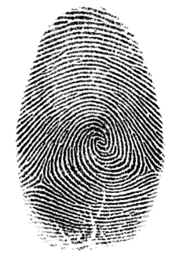
Easy Solution? NO
Biggest problem:
data acts as a “fingerprint”
identification feasible without identifiers
Example using the 2000 US census:
“Revisiting the Uniqueness of Simple Demographics in the US Population” Philippe Golle, PARC

Slide 8
Curse of Dimensionality
Less information
More information
“Revisiting the Uniqueness of Simple Demographics in the US Population” Philippe Golle, PARC

Slide 9
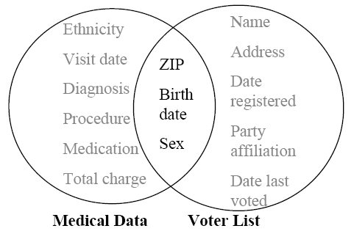
Example of Linking Attack
How to re-identify the medical record of the governor of Massachusetts (L. Sweeney 2002)
MA collects and publishes sanitized (i.e. identifiers removed) medical data for state employees left circle
voter registration list of MA (publicly available) right circle
looking for governor’s record
6 people had his birth date
3 were men
1 in his zipcode
9

Slide 10
Definitions for Quantifying Privacy
taxonomy of attributes
explicit identifiers are removed
quasi identifiers can be used to re-identify individuals
sensitive attributes (may not exist!) carry sensitive information
identifier | quasi identifiers |  |  | sensitive
Name | Birthdate | Sex | Zipcode | Disease
Andre | 21/1/79 | male | 53715 | Flu
Beth | 10/1/81 | female | 55410 | Hepatitis
Carol | 1/10/44 | female | 90210 | Bronchitis
Dan | 21/2/84 | male | 02174 | Sprained Ankle
Ellen | 19/4/72 | female | 02237 | AIDS

Slide 11
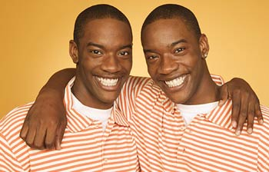
K-Anonymity
Sweeney and Samarati proposed the standard of k-anonymity, goal, not an algorithm
A data set is k-anonymized if each record is indistinguishable among k-1 other records
each set of quasi-identifiers should appear at least k times in the released data
linking impossible with confidence >1/k
E.g. 2-anonymity:

Slide 12
K-Anonymity Example
Example of achieving 2-anonymity using generalization and suppression operators
Outlier records can be suppressed
original data
2-anonymous data
Birthdate | Sex | Zipcode
21/1/79 | male | 53715
10/1/79 | female | 55410
1/10/44 | female | 90210
21/2/83 | male | 02274
19/4/82 | male | 02237
 | Birthdate | Sex | Zipcode
group 1 | */1/79 | person | 5****
 | */1/79 | person | 5****
suppressed | 1/10/44 | female | 90210
group 2 | */*/8* | male | 022**
 | */*/8* | male | 022**

Slide 13

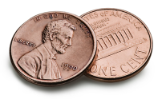
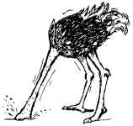

Privacy vs. Utility
How useful is the anonymized data?
What is the best trade-off between privacy and utility?
Data Utility
Data Privacy

Slide 14
Transparency

Slide 15
Ethics
What actions does your analysis/model/system enable?
Could those hurt certain people?
What can you do to protect against it?

Slide 16
Bias
Could your models be biased?
Sources of bias
Training data
Validation process

Slide 17
Cost/Benefit Matrix
Actual
0
1
TN
FN
0
Predicted
1
FP
TP

Slide 18
Ethics, Fairness, Transparency
Good discussion at http://www.fatml.org/2014/

